Slide 1
OSLC CONGREGATIONAL ASSEMBLY
June 2, 2024

Slide 2
Agenda
Greetings
Opening Devotion
Taking of Attendance
Signing of Bylaws/Constitution by Confirmed Members
Presentation of Minutes
Pastoral Report
Financial Report
Old Business
    Property & HVAC Replacement
New Business
    Call committee update with Resolution to amend Call Process
    2024-2025 Ministry Action Plan with resolution to approve
    Staffing change
    Opportunities to serve
    - Governance Board Election Results
Announcements
Adjourn with Prayer
Notes:
5/20/24

Slide 3
Opening Devotion
Elder: Liz DeMik
Notes:
1/29/2023

Slide 4
PASTOR FLAHN REPORT

Slide 5
FINANCIAL REPORT

Slide 6

Where Have We Been?
Notes:
I found the slides from August/September and updated those. This is a mid course check.

Slide 7
Cash on hand on December 31, 2023
$998,428
Mortgage balance
$1,424,529
Notes:
From last assembly – just moved them over – not sure where Pastor Peter got the $870,182 - I think that is closer to $1,007,000

Slide 8
Where Are We Now?

Slide 9
Cash on hand on April 30, 2024
$944,428 ⇒ $735,325
Mortgage balance
$1,424,529 ⇒ $1,374,535
Paid down $102k against mortgage principle since Aug 2023. Project term varies with interest rate.
Notes:
Mortgage balance from Mortgage statement –
Cash on hand came from treasurers report – just the LCEF and PNC accounts
May have been reported low last time. If you look at the graph and look up August you see $1,007 K and I think that is more accurate

Slide 10
LOANS
LCEF Mortgage
Balance: $1,362,722
Monthly payment: $18,427
Variable interest
LCEF SMART LOAN
Balance: $136,250
Monthly payment: $1,250
Interest 0% through June 14, then 3.5%
PPP LOAN
Balance: $3,001

Slide 11
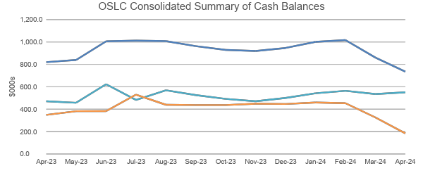
OSLC Consolidated Summary of Cash Balances
Notes:
Got this from the November treasurer’s report should be close enough

Slide 12
Church Financial Activity FY 2024 Sept-April
Giving: $532,708
General Fund Expenses: -$548,344
Total: -$15,636
Giving: $104,435
Designated Fund Expenses: -$351,475
Total: -$247,040
Giving: $637,143
Total FY24 Expenses: -$899,819
Total: -$262,676
Notes:
Used FYTD Budget VS actual report – only $7 K behind based on this report. May want to note that the donation to designated funds do not necessary line up with – need to keep them separate

Slide 13
Open Arms Financial Activity
FY 2024 Sept-April
Tuition/contributions: $1,140,810
Expenses: -$1,148,554
FY24 Total: -$7,744
Note: Some of this is accounts receivable from DSS
Notes:
Got this from the Open Arms General & Designated Activity 9/1/2023 through 12/31/2023 Using Consolidated Budget. Some of this is late payment from DSS and some parents behind.

Slide 14
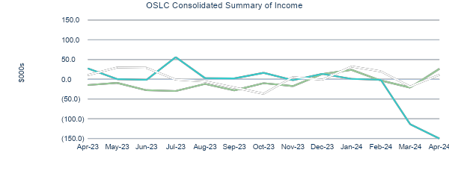
OSLC Consolidated Summary of Income
Notes:
Got this from the May treasurer’s report should be close enough

Slide 15
Thanks Be To God!

Slide 16
HVAC Replacement Complete!
OLD BUSINESS

Slide 17


Slide 18
HVAC Invoice
Original Estimate: $377,624
Change Orders:
TEMP CONTROLS $1,500
ADDED CONTROLS $7,320
TEMP COOLING $24,782
WEEKEND INSTALL $6,855
Total $418,081
Overage: $40,457

Slide 19
Facilities Update
OA HVAC: Installed; awaiting final TAB
Solar Credit: Are we getting? Doing deep-dive analysis
Workday: Great success; much accomplished
Dry-pipe suppression system: Monitoring
New Security Alarm: Operating well; new Digital FOBs
OA Cameras: New camera system in place
Fire Alarm Voice Fault: 2x PC boards to be replaced

Slide 20
Facilities Update
LED Conversion: Almost finished
Recycle: Asking for volunteers/team to manage
Kitchen Use: Volunteers drafted policy; under review
Prayer Room Carpet: Needs to be replaced; plan in place
Sign: Not repairable; approx. $30k to replace
Fellowship Hall Back Door: Needs major rebuild; $$$

Slide 21
Call Committee Resolution
Additions to current approved resolution:
Resolved that the Call Committee do a second round of interviews, followed by a congregational forum discuss the candidates; be it further
Resolved that the top two candidates be invited for a visit prior to the Call Service to meet with congregational leaders; tour the facility and community; and have a reception with the congregation; finally be it

Slide 22
FY 25 Ministry Action Plan
Target Area 1:
New Senior Pastor Preparation and Transition: Continue progress in identifying and addressing policy, procedure, and facility gaps to enable the successful transition to a new Senior Pastor.

Slide 23
FY 25 Ministry Action Plan
Target Area 2:
Witness, Outreach and Communications: Equipping Congregation to Invite; reaching further into the community; spreading awareness about OSLC and the Lord; identify, evaluate, and develop modes of communication within congregation. Deliberate efforts to reach greater Laurel Latino community through specific language resources and programs; translation of message during worship (simulcast); one Spanish speaking Bible class or small group; restart ESOL or teach English using the Bible as the text book.

Slide 24
FY 25 Ministry Action Plan
Target Area 3:
Community Building: Equip leaders, deploy members, and build strong network of small groups where we live, work, learn, play, and worship; identify three to five deliberate measures to evaluate success of small groups. Explore specific opportunities to better engage young adults.

Slide 25
FY 25 Ministry Action Plan
Target Area 4:
Children’s and Youth Ministry: Continue and grow current programs; provide parent resources/classes; provide homeshool support; encourage parental participation in small groups like Manna for Moms; build bridges between Open Arms and OSLC. Expand nursery care and support for groups with small children. Explore and provide opportunities for youth to participate in regular confirmation classes, Sunday School, and worship services.

Slide 26
FY 25 Ministry Action Plan
Target Area 5:
Prayer: Prayer focused events such as Prayer Vigils, Fresh Start, Prayer Chain, Prayer Groups, Prayer Requests, etc; Develop Messages/Sermon Series on prayer; pray in small groups.

Slide 27
FY 25 Ministry Action Plan
Target Area 6:
Stewardship: Implement a deliberate Stewardship Program that raises the awareness within the Congregation of specific resource gaps and gains commitment of time, talent, and treasure of members and friends of the Congregation in order to meet immediate and longer term needs

Slide 28
New Business
Staffing Change: Brenda Petito

Slide 29
Opportunities to Serve
VBS 22-26 July Many volunteers needed!
Meals for Mission Teams
Food Bank
Elizabeth House
Recycling assistance
Landscape Maintenance
Worship Support

Slide 30
New Business
Governance Board Election Results:
Tina McGuffey (re-elected)
Brian Modeste
Brenda Petito
We give thanks to Johan Stewart for his faithful dedication and commitment to OSLC and for being willing to serve on the Governance Board

Slide 31
Final Announcements
Our next Congregational Assembly will be In Sep 2024
Want to thank the Board, especially Paul Ogunboye who has completed his term of service; as well as current staff, finance committee and all our ministry teams and workgroups for their hard work and commitment to OSLC mission and ministries.

Slide 32
CLOSING PRAYER

